Slide 1
Principle Component Analysis－－Jian Sun
Definition
A principal component analysis is concerned with explaining the variance-covariance structure of a set of variables through a few linear combinations of these variables.
Its general objectives are
data reduction;
interpretation.

Slide 2
Step1: Variance-Covariance Matrix S
According to the result of linear regression, we keep the following predict variable:
1 Graduate GPA; 2 the time of staying in English speaking country; 3 work experience; 4 the number of interview
The we get variance-covariance matrix S from these variables,
> CND FP.G.gpa FP.T.ESC FP.X FP.I
FP.G.gpa 0.0350976778 -0.0008436139 0.1968251 0.003896952
FP.T.ESC -0.0008436139 5.1692670537 2.3007983 -0.681966618
FP.X 0.1968251089 2.3007982583 26.3867925 3.265965167
FP.I 0.0038969521 -0.6819666183 3.2659652 47.091436865

Slide 3
Step2: Eigenvalues and Eigenvectors
Then the eigenvalues and eigenvectors of the S are:
> eigen(CND)#get their eigenvalues and eigenvectors
$values[1] 47.59690531 26.15463183 4.89750755 0.03354936
$vectors [,1] [,2] [,3] [,4]
[1,] -0.0007075636 0.007376197 0.004608463 0.9999619258
[2,] 0.0076790095 0.112557423 -0.993608456 0.0037543383
[3,] -0.1513760066 0.982296648 0.110076410 -0.0078603045
[4,] -0.9884461729 -0.149565083 -0.024580111 0.0005171293

Slide 4
Step 3: prcomp()
By using prcomp() in R, we get two principal component.
> PCA=prcomp(CND, retx = TRUE, scale. = FALSE)
> summary(PCA)
Importance of components: PC1 PC2 PC3 PC4
Standard deviation 23.39 12.00 2.08 3.516e-17
Proportion of Variance 0.787 0.207 0.006 0.00
Cumulative Proportion 0.787 0.99 1.00 1.00
The proportion of 入1 is 78.7%, the proportion of 入2 is 20.7%
Notes:
79% proportion of variance is attributed to Pc1, and 21% proportion of variance is attributed to pc2. so we keep the first two to less loss of information.

Slide 5
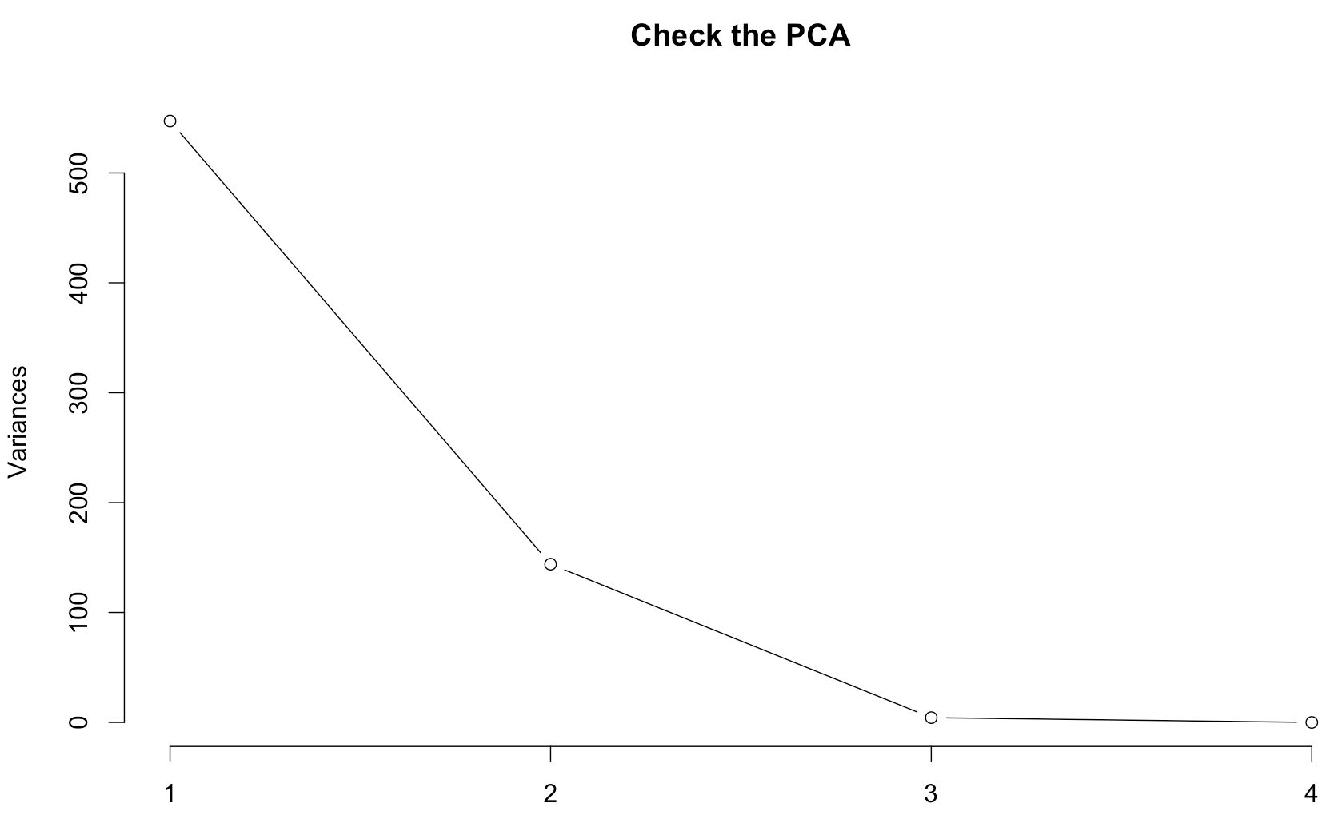
Using Scree plot() to choose PC again
Then we use screeplot() to check our result.
Usually, we will keep the PC where has a clear bent.
From the plot, there is a clear bent in PC2. So we decide to use the first two principal components
Notes:
Then we use this plot to prove our result

Slide 6
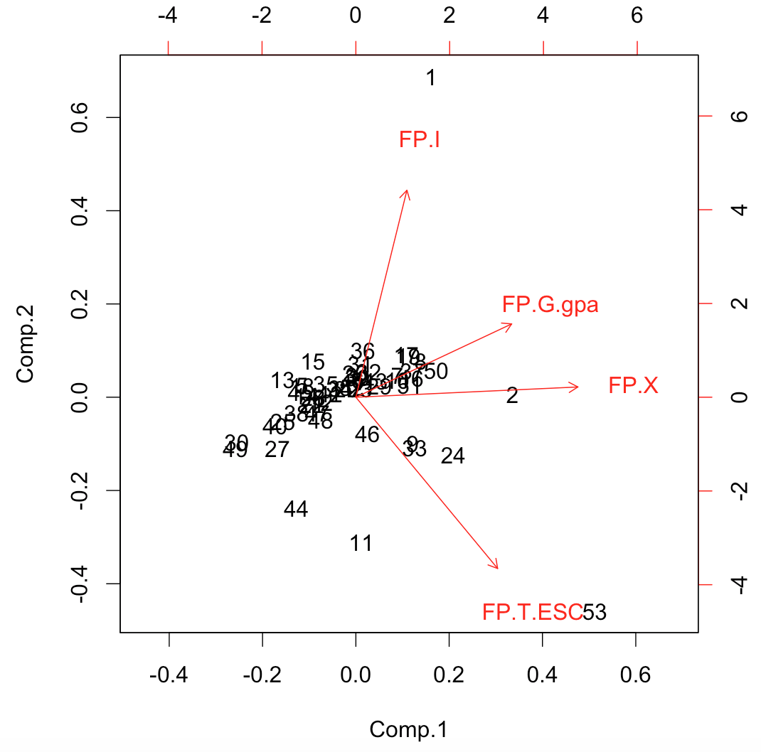
The Biplot for PC
The result of 9th ,33th, 53th sample stays so many years in English speaking country;
The result of 2th sample has more working experience than other samples;
The result of 17th,19th 50th sample are influenced by working experience, years and age;
The results of 36th is influenced by the numbers of interview.

Slide 7
Step 4: Detail equation
According to the cumulative proportion: we keep the first two principal:
PC1:
Y1=-0.00071*G_GPA + 0.0077*TESC - 0.15*X - 0.988*I
PC2:
Y2=0.0074*G_GPA + 0.113*TESC + 0.982*X - 0.1496*I

Slide 8
Explanation of PCA
The practical mean of the PC
PC1: the degree of melting. The more years you stay in English speaking country, the more you know about western world. It has positive influence on your job offers
PC2: comprehensive ability. A person who is awesome at study, English and working experience will have more chance to get an offer.

Slide 9
Conclusion
We deduct our dataset to 2 dimension by using principal component analysis.
They are PC1 represents the degree of melting; PC2 represents comprehensive ability.
PC1: Y1=-0.00071*G_GPA + 0.0077*TESC - 0.15*X - 0.988*I
PC2: Y2=0.0074*G_GPA + 0.113*TESC + 0.982*X - 0.1496*I

Slide 10
PCA disadvantages
Principal component analysis is an unsupervised learning technique( do not use class information).
In details, when we analyzed the data, we did not separate the data according to their degree or the courses they chose.
I think these two variables will lead to a different result if we separate the data following them.
So to do a more precise analysis, we did classification in the next part.

